Slide 1


Slide 2



Southern Ohio Veterans Memorial Highway
State Route 823
Notes:
----- Meeting Notes (3/3/16 09:40) -----
chancge PGG logo to SR823 version

Slide 3

PRESENTATION OVERVIEW
Project Overview
Public Private Partnerships (P3)
Why P3 for SCI-823?
Project Update
Questions and Answers

Slide 4
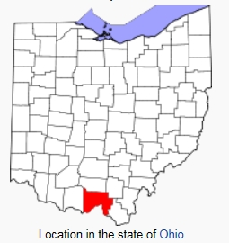
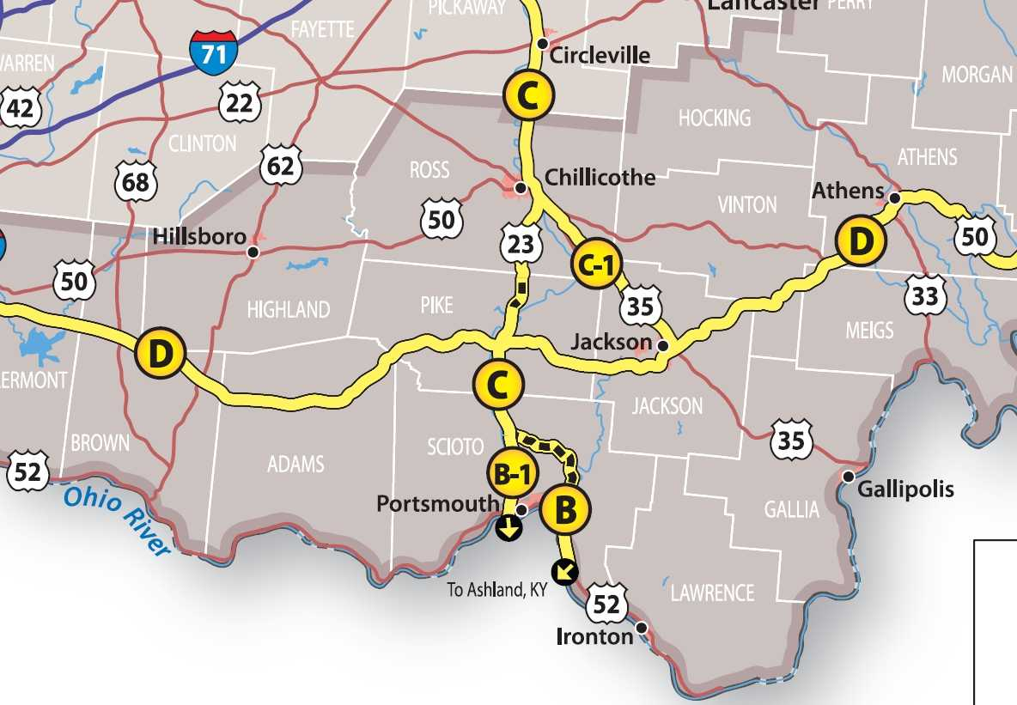
Project ROUTE
Project Location
  Rural community in Scioto County
  90 miles south of Columbus, OH
  100 miles east of Cincinnati, OH

Slide 5
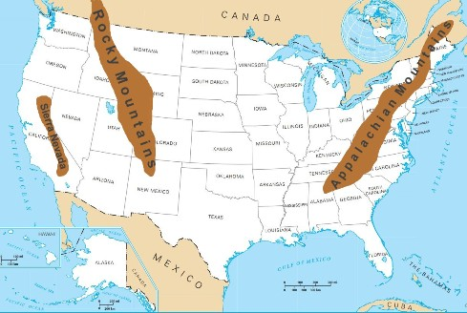
Appalachian Mountain Range

Slide 6
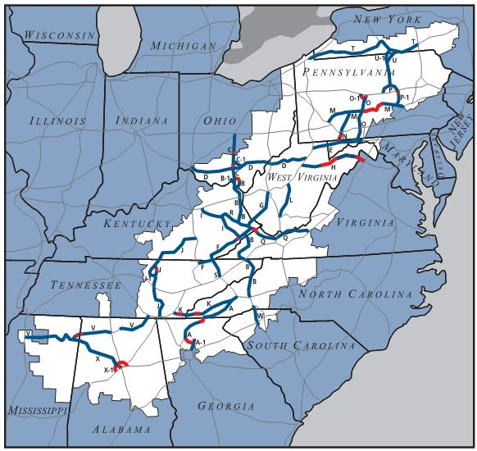
Project Purpose and Need
The Appalachian Highway system is designed to:
    Generate economic development;
    Connect Appalachia highways to interstate system;
    Improve Regional & National market access.
Completes Appalachian Highway in Ohio
Reduces current 26 mile travel time by avoiding:
    30 traffic signals, 80 intersections, 500 driveways
Improves safety and congestion

Slide 7


ORGANIZATION
Quality Oversight
Public Private Agreement
Lenders
Developer
TIFIA
Financing Agreements

Slide 8
HOW IT ALL GOT STARTED AS A P3
HB 114 (March 2011) allowed ODOT to use P3 delivery models
ODOT conducted statewide review of potential P3 projects
SCI-823 was already well developed and “ready to go”
    Originally Design-Bid-Build in 3 Phases
    Scope Defined and Design >50% complete
    Environmental Documents complete
    ROW purchase underway
Value for Money study conducted – identified single phase Design-Build-Finance-Operate-Maintain (DBFOM) approach
ODOT submitted application for Rural TIFIA loan early

Slide 9
WHY P3 FOR SCI 823?
Accelerate delivery of the project by 17 years
Delivers the complete project rather than in phases
Allow ODOT to pay for the project over longer period
Achieve competitive, firm fixed price
Substantial risk transfer to private sector
        Geotechnical Risk
        Design and Construction Risk
        Schedule Risk
        Finance Risk
Generates economies of scale related to construction
Effective long-term warranty through performance specifications and 35 year O&M contract

Slide 10
PROCUREMENT TIMEFRAME
Total Duration – 3 years

Slide 11





ORGANIZATION
Quality Oversight
Equity Members
Public Private Agreement
Lenders
Developer
TIFIA
Financing Agreements
40%
PAB’s
40%
20%
Operations & Maintenance
(Developer Self-Performance)

Slide 12
INFRASTRUCTURE PROCUREMENT IN THE US
Traditionally:
Design-Bid-Build (DBB)
“Alternative Delivery”:
Design-Build (DB)
Public Private
Partnership (P3)
Fully Designed
Outline Specifications
Performance Specifications
Public
Private
Construction
Design and Construction
Design, Construction, Operate, and Maintain
Contract Length
1-5 years
1-5 years
20-30 years
Notes:
In the traditional public-sector procurement (aka DBB):
the public authority

Slide 13
Risk Sharing:
DBB (Traditional)
PUBLIC
PRIVATE
Project interfaces
Right of Entry
Environmental & Historical Artefacts
Geotechnical (site)
Technical (constr.)
Contractor Failures
SHARED
Cost overrun
Quality
Site Construction
Contractor Failures

Slide 14
RISK SHARING:
DBFOM (P3)
PUBLIC
PRIVATE
Geotechnical (site)
Site Construction
Technical (construction)
Cost overrun
Quality
Contractor Failures
SHARED
Right of Entry
Environmental & Historical Artifacts
Project interfaces
Notes:
----- Meeting Notes (3/3/16 09:40) -----
add other venn diagram that contrasts other project delivery methods

Slide 15
P3 Delivery Option
Projects Sponsors
Government Subsidy
P3 Special Purpose Vehicle
Equity Investors
Private bank loan
Operations & Maintenance
Detailed Design & Construction
Local subcontractors
Local subcontractors
Notes:
DBF and DBFOM
Key take-away: Financiers are exposed to the long-term project performance.
1. Analysis considered 3 delivery options:
DBB – traditional, the benchmark for comparison
DBF – private design, build and finance
DBFOM – private design, build, finance, operation & maintenance
2. DBFOM process is:
Create an SPV whose sole purpose is to build, operate and maintain the project.
Sponsors define the project scope and the minimum performance.
Sponsors set performance standards, and make payments to the SPV.
SPV’s financers seek to pass down risk to Design-Build and O&M contractors.
3. Risk transfer is achieved with:
Efficient procurement and implementation
A bankable SPV risk profile being established
Sponsors enforcing satisfaction of the project scope and performance

Slide 16
P3 – HOW IT WORKS ON SCI-823
Developer prepares own design and construction specs – no ODOT design or specs
Developer builds DMF according to those criteria – performs own QA/QC
Developer gets 3 milestone payments during construction
After construction, Developer earns fixed price Availability Payment for 35 years
  Facility must perform to pre-established performance specifications
  Monthly payment subject to Unavailability Deductions
  Monthly payments subject to Non-Compliance Events deductions
Developer will “own” what they build for 35 years; any cost overruns or defects in the project are the responsibility of the Developer
  Developer will perform routine maintenance (e.g. roadside sweeping, mowing, etc)
  Developer performs major rehab (e.g. pavement resurfacing, bridge repair, etc)
After 35 years of operations, developer hands back roadway to ODOT in a good condition or suffers deductions
ODOT will perform Snow Plowing, Emergency Incident Response

Slide 17



ORGANIZATION
Quality Oversight
Equity Members
Public Private Agreement
Lenders
Developer
TIFIA
Financing Agreements
40%
PAB’s
40%
DB Agreement
20%
DB Joint Venture
Operations & Maintenance
50%
(Developer Self-Performance)
30%
20%

Slide 18
PROJECT SCOPE
Largest single project ODOT has ever done ($429M) – First P3
16-mile, 4-lane, limited access highway through mountainous terrain of SE Ohio
Bypasses 26 miles of US 23 and US 52, crossing NS and CSX Railroads
High fill embankments (> 180’) and deep culverts (> 170’)
Originally 3 phase construction – now one phase
Developer Maintained Facilities and Locally Maintained Facilities
Performance Based Specifications for DMF

Slide 19
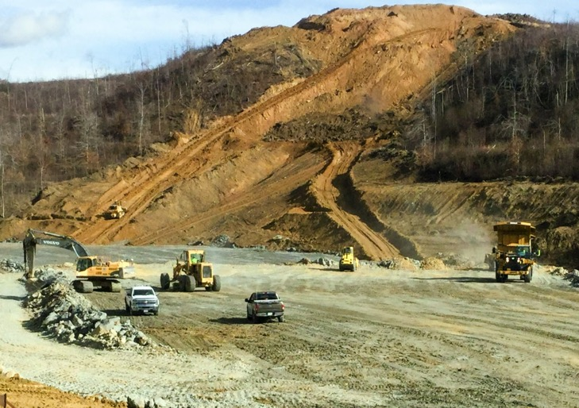
Major Project Components
GENERAL
Greenfield project
820,000 SY/340,000 TN of pavement
5 interchanges
80+ Major Culverts
  Significant Expected Settlement
20M CY Excavation, 95% rock
+300,000 SF MSE Wall
21 Structures (Steel and Concrete)
ODOT Preconstruction Activities
  Acquisition of ROW
  Tree clearing for Phase 1 of Project
  Removal of all structures and gas station at SR 140
  Relocation of AEP transmission lines

Slide 20
Project timeline
Financial Close
End of Term
Dec. 2053
NTP: Design Work start
Commencement of Construction
Substantial Completion
Date
Funding of Handback Reserve
Final Acceptance Date
CONSTRUCTION PERIOD: 3 years – 8 months
OPERATING PERIOD: 35 years
120 days
2 years
April 2015
June 2015
Dec. 2018

Slide 21
CONSTRUCTION SCHEDULE
Financial Close
Commencement of Construction
Substantial Completion
Final Acceptance
April 2015
June 2015
2016
2017
2018
Dec 2018
April 2019
Design
Utilities
Wick Drains
Culverts
Excavation – Segment 1
Excavation – Segment 2
Excavation – Segment 3
Excavation – Segment 4
Pavement
Structures
Finishes

Slide 22





ORGANIZATION
Quality Oversight
Equity Members
Public Private Agreement
Lenders
Developer
TIFIA
Financing Agreements
40%
PAB’s
40%
DB Agreement
20%
DB Joint Venture
Operations & Maintenance
50%
(Developer Self-Performance)
30%
20%
Designer
Design Subconsultant

Slide 23
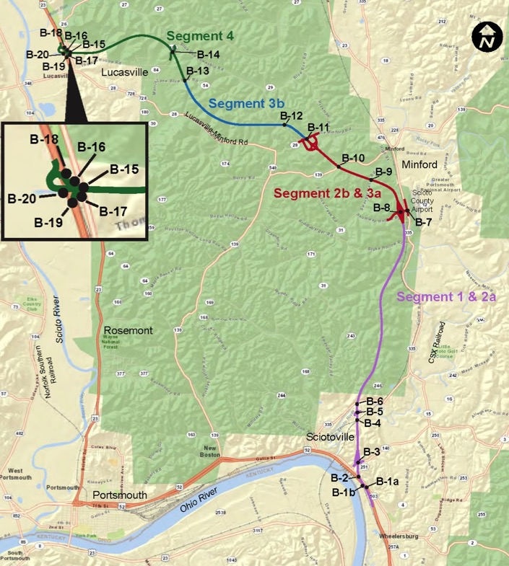
Design PHASING
  Phase 1 = Segment 2B/3A
  Phase 2 = Segment 3B/4
  Phase 3 = Segment 1/2A
    Each individual bridge a separate buildable unit
    Separate culverts buildable unit for each segment
    Separate grading buildable unit for each segment
    Finish grade / drainage package separate

Slide 24

ORGANIZATION
Quality Oversight
Equity Members
Public Private Agreement
Lenders
Developer
TIFIA
Financing Agreements
40%
PAB’s
40%
DB Agreement
20%
DB Joint Venture
Operations & Maintenance
Independent Quality Firm
50%
(Developer Self-Performance)
30%
20%
Designer
Design Subconsultant

Slide 25
Independent Quality Firm
Major Responsibilities
Accept all design and construction work
  Design reviews
  Construction inspection QA
  Testing
Create, operate, maintain an electronic document management system for the project
  Web based EADOC for final documents
  Web based SharePoint for design review
  Web based “DEMAR” database for test results
Provide Duty of Care to ODOT and the Developer
Be and remain completely independent

Slide 26





QUESTIONS?
www.PGG823.com
Southern Ohio Veterans Memorial Highway
SR-823/SOVHM

Slide 27
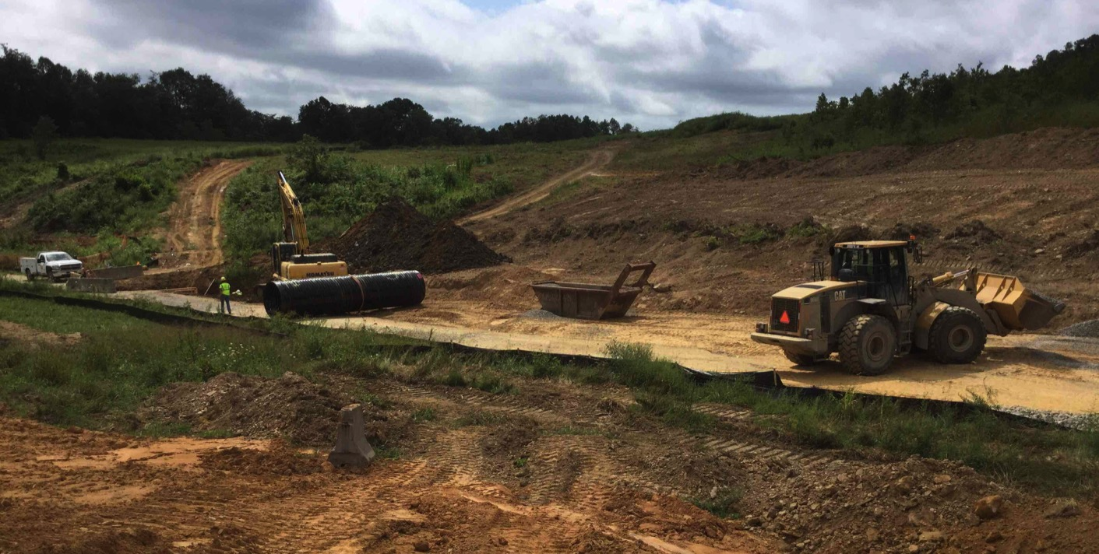
Excavation for culvert pipe – August 2015

Slide 28
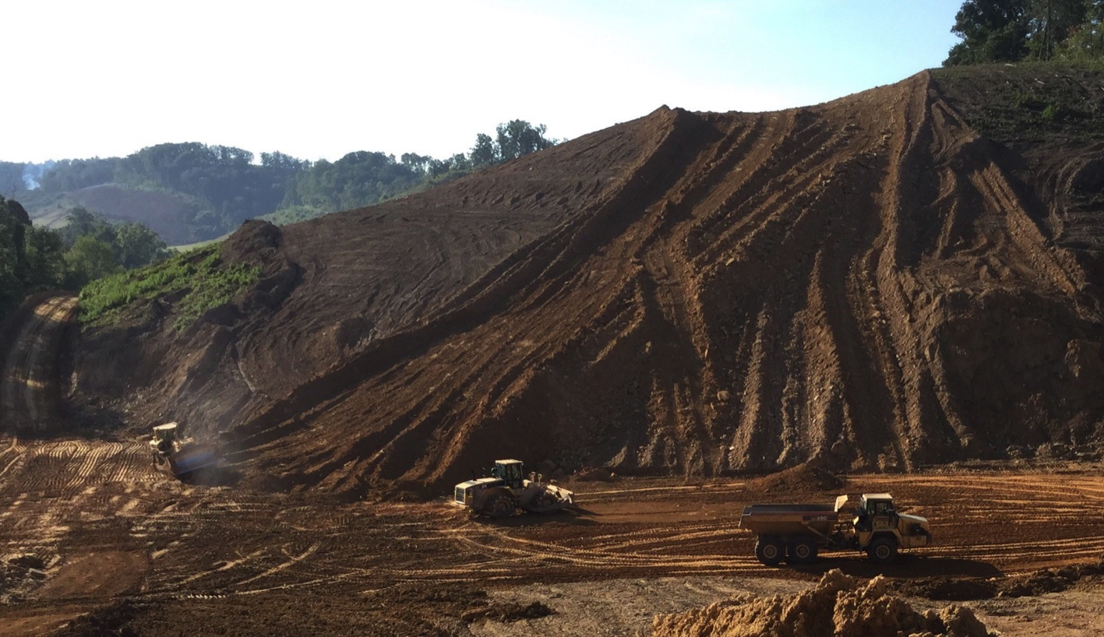
Embankment placement – August 2015

Slide 29
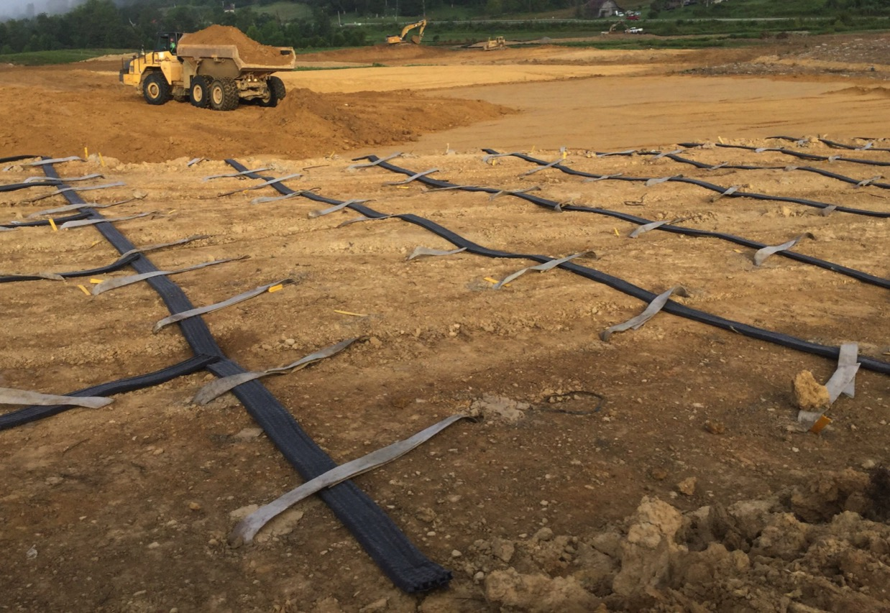
Connection of wick drain and strip drains – August 2015

Slide 30
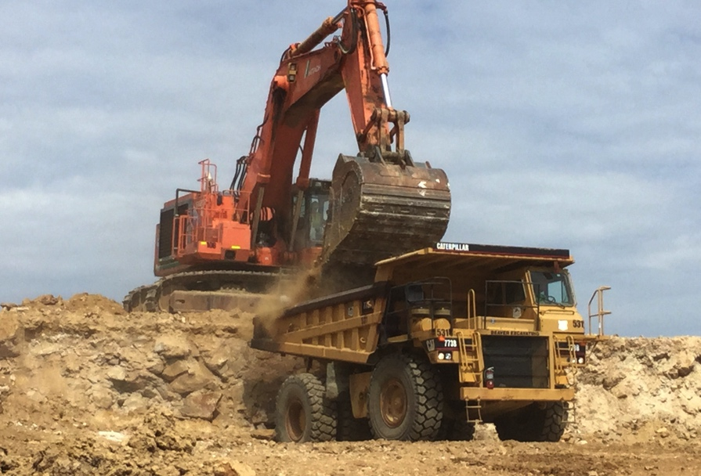
Hitachi 1200 excavator loading CAT 773 with shot rock – September 2015

Slide 31
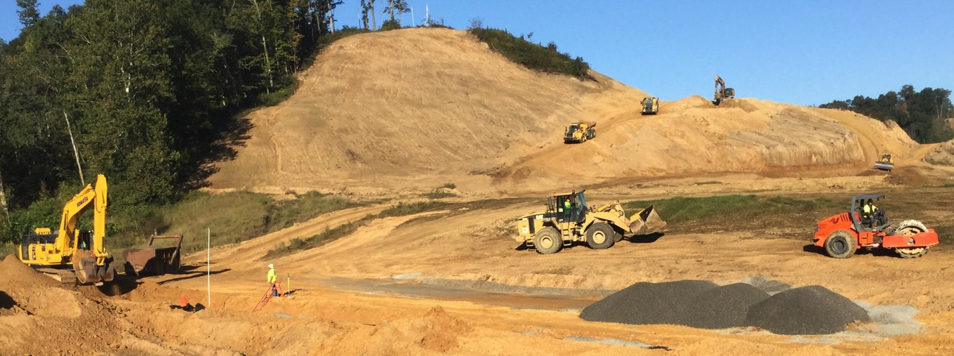
Backfill placement over culvert – September 2015

Slide 32
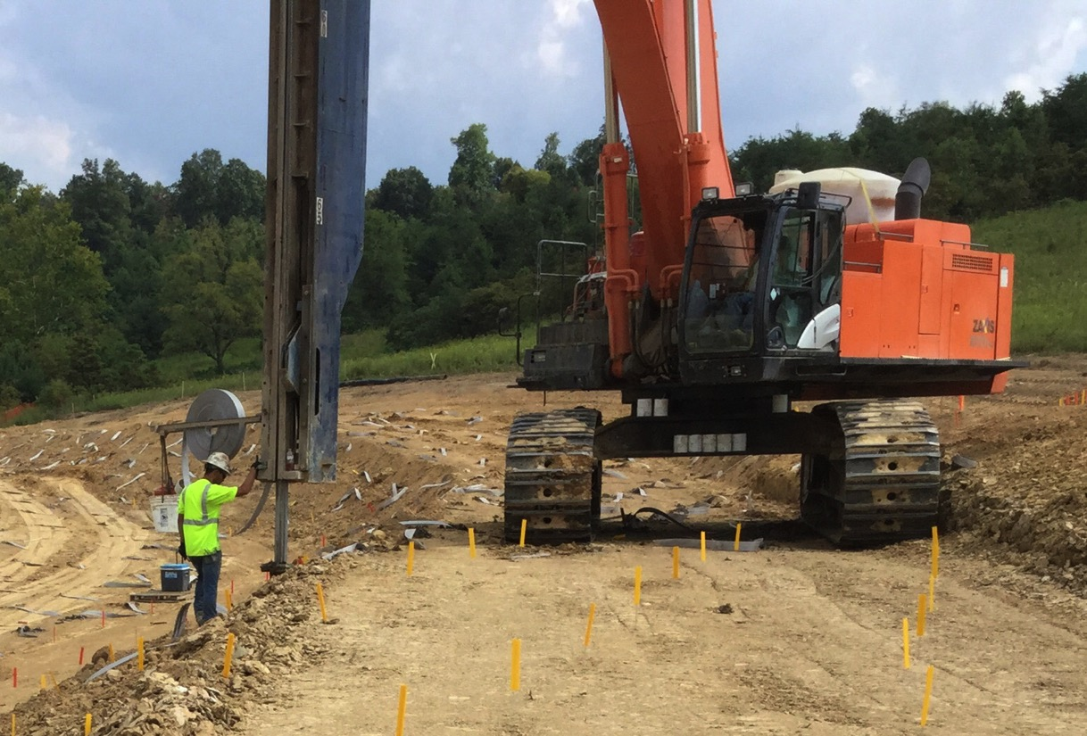
Wick Drain Installation – September 2015

Slide 33
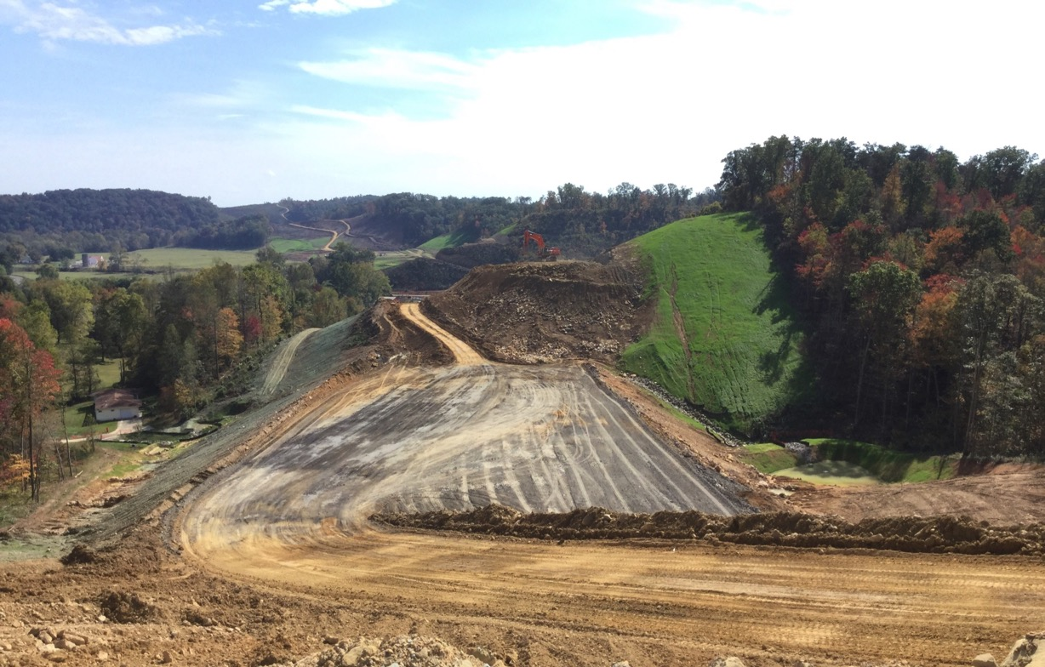
Shot rock placement for embankment – October 2015

Slide 34
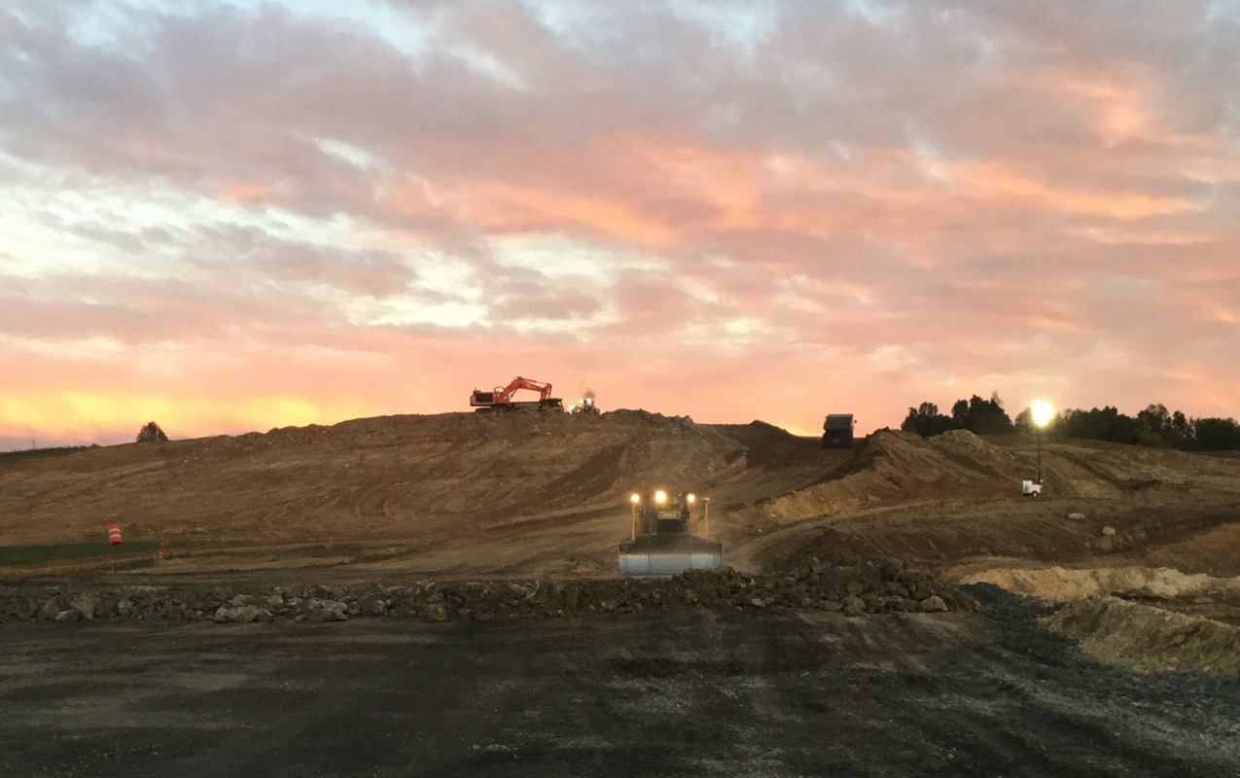
Mass rock fill along the mainline – night work – October 2015

Slide 35
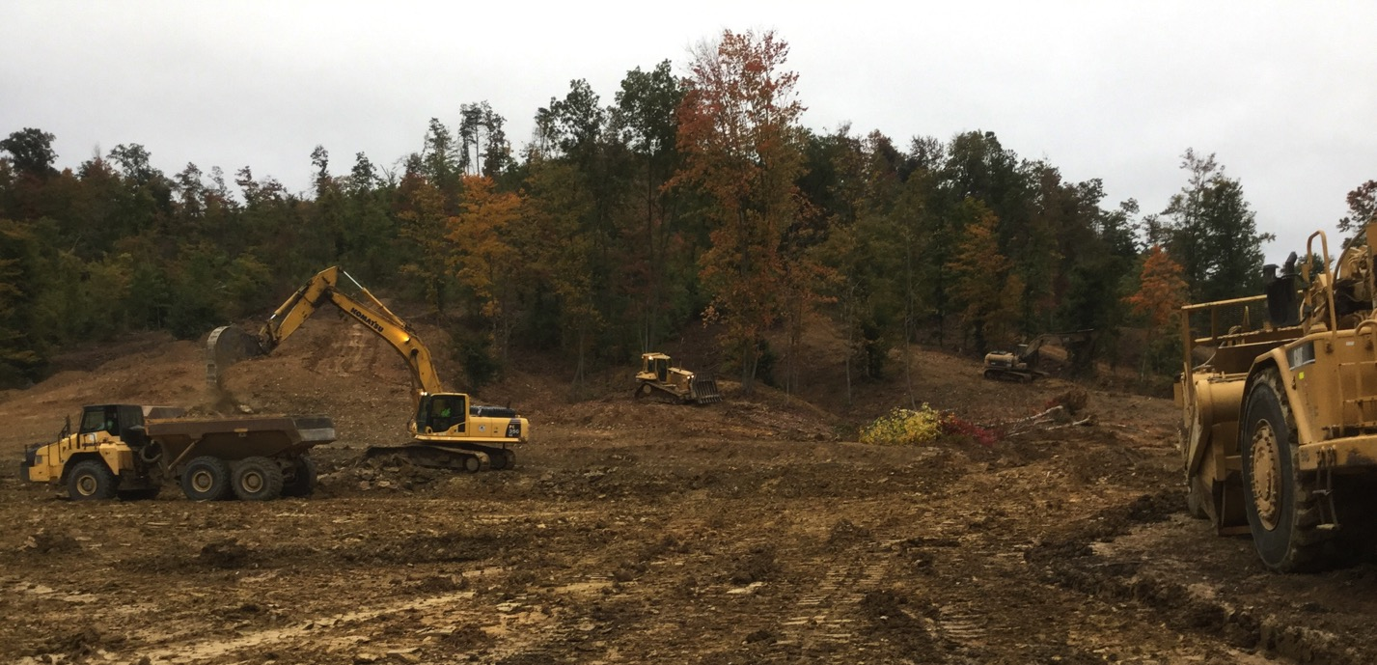
Clearing and grubbing – October 2015

Slide 36
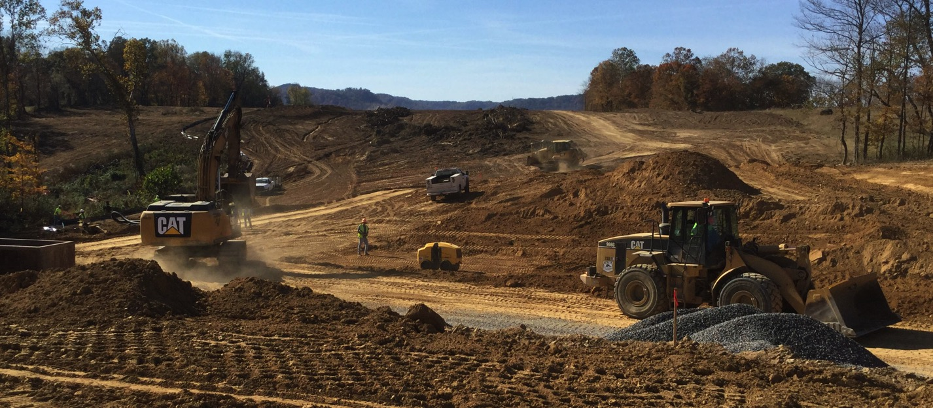
Embankment placement – October 2015

Slide 37
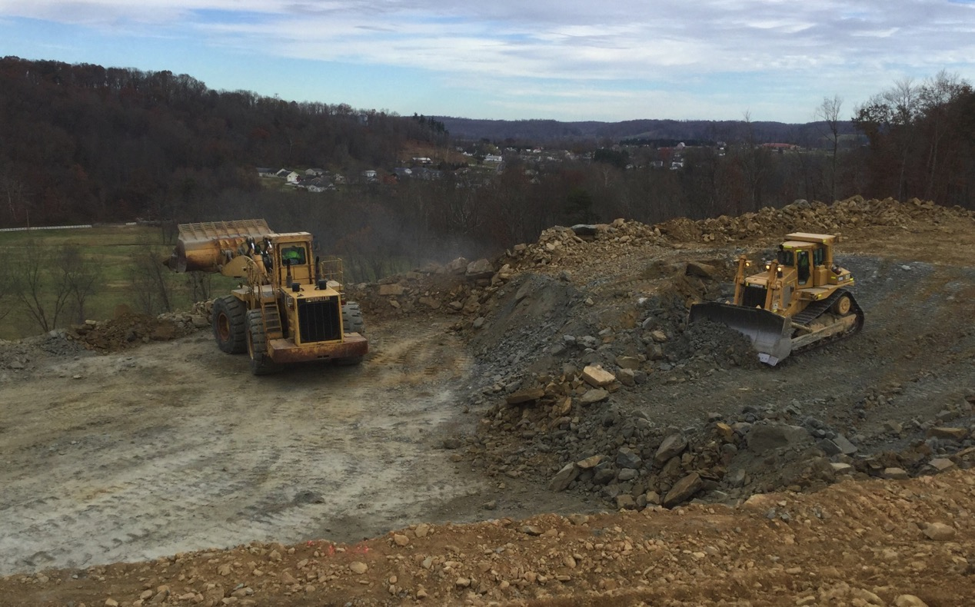
Rock fill along the mainline – November 2015

Slide 38
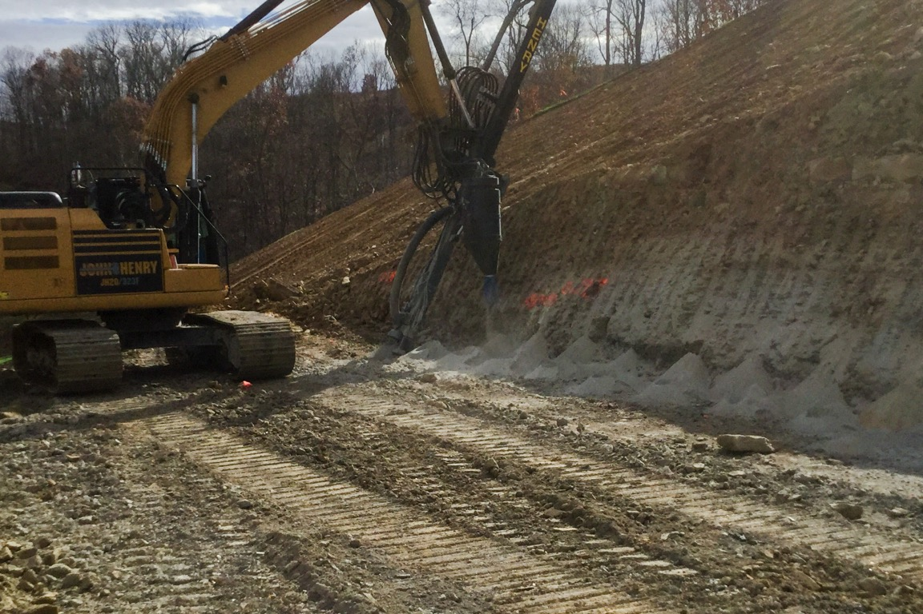
Drilling rig drilling pre-split holes – November 2015

Slide 39
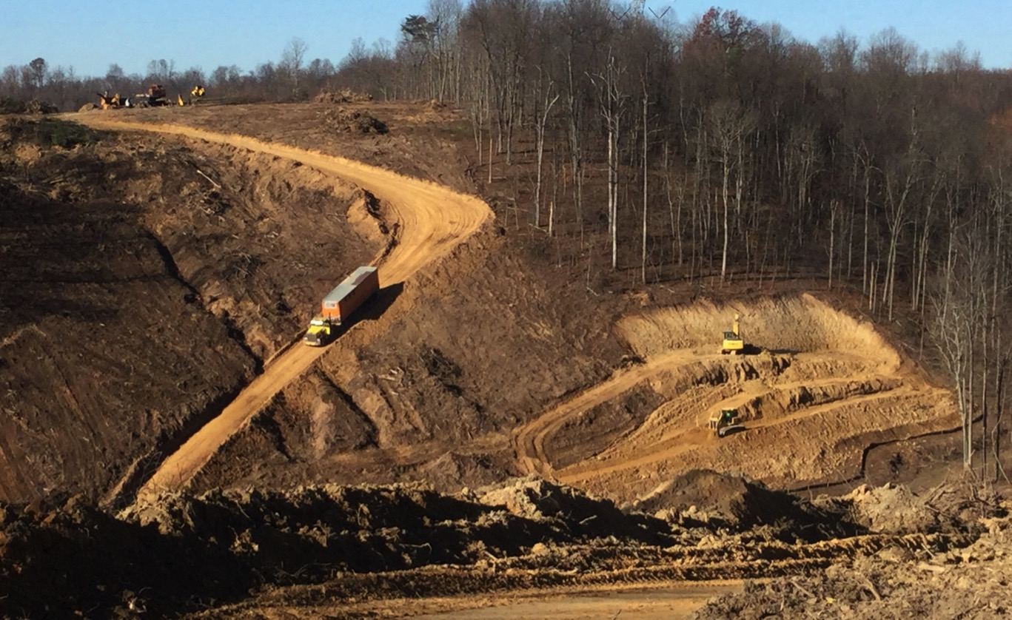
Clearing and grubbing – November 2015

Slide 40
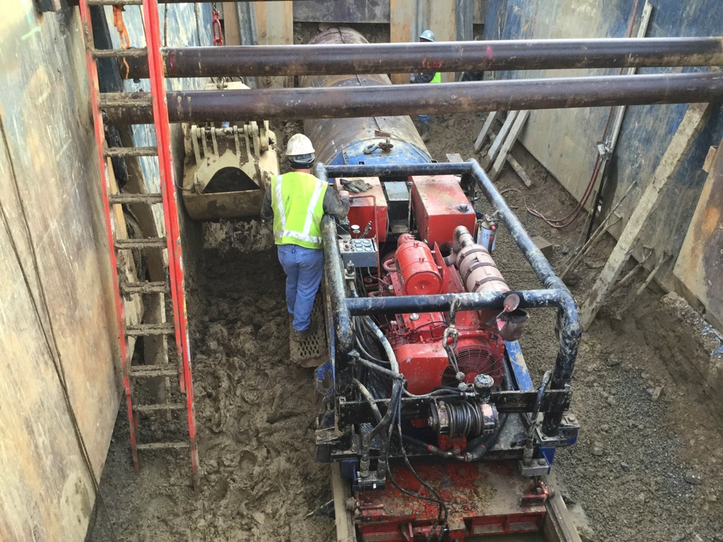
Jack and bore operation – December 2015

Slide 41
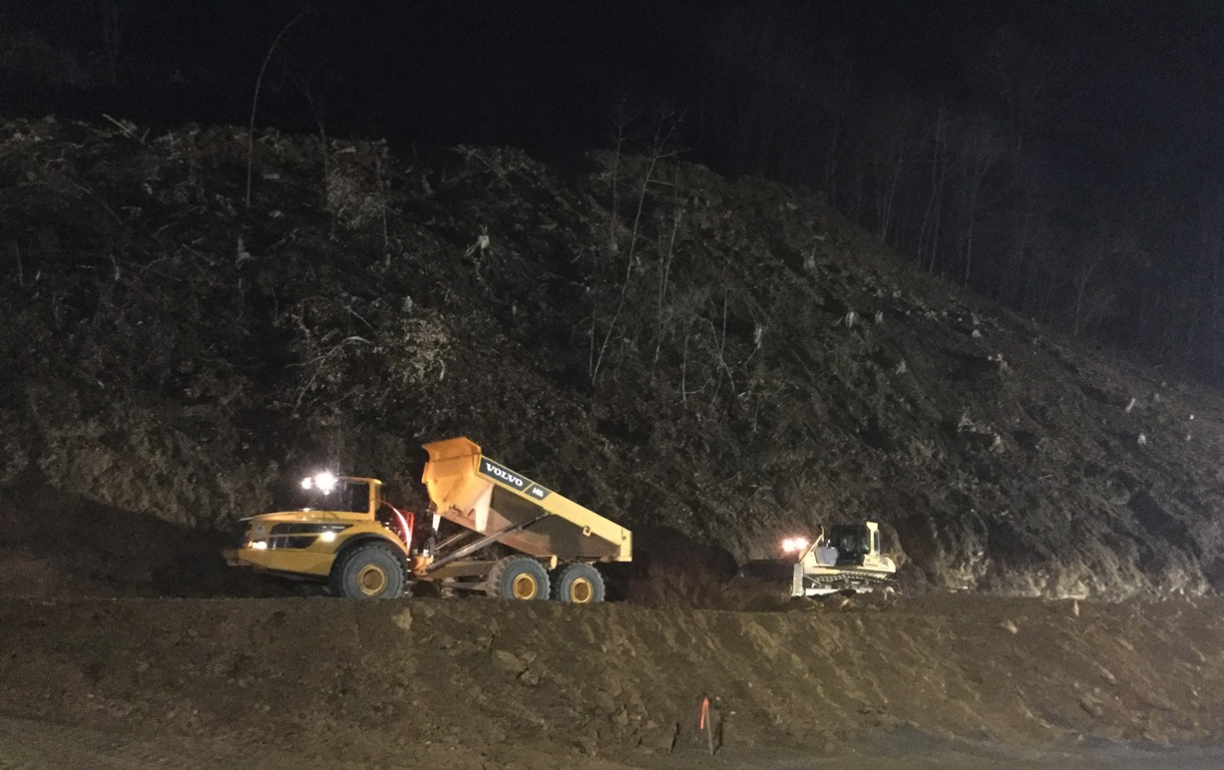
Rock fill placement – night work – December 2015

Slide 42
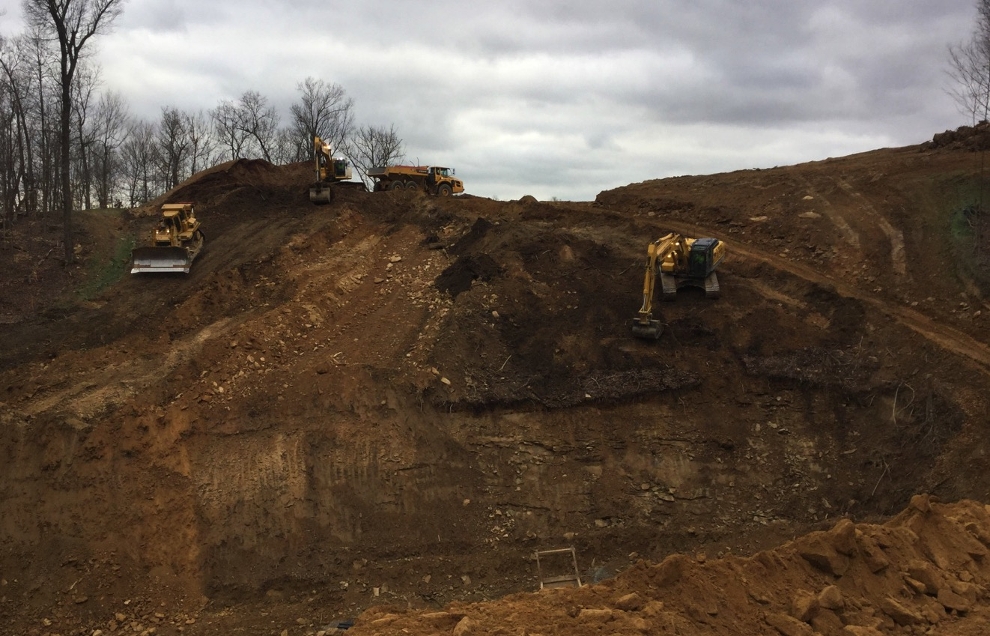
Scalping ravine slope and removing mulch – December 2015

Slide 43
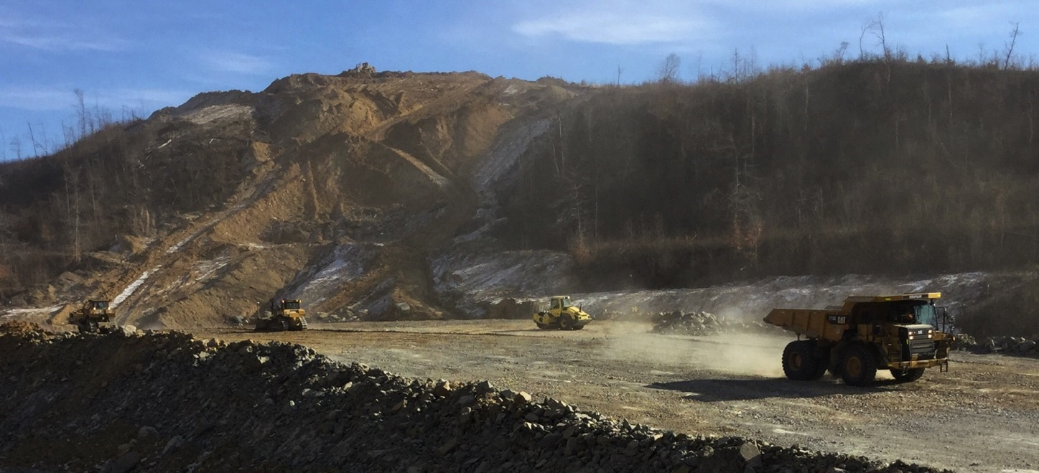
Shot rock placement along the mainline – January 2016

Slide 44
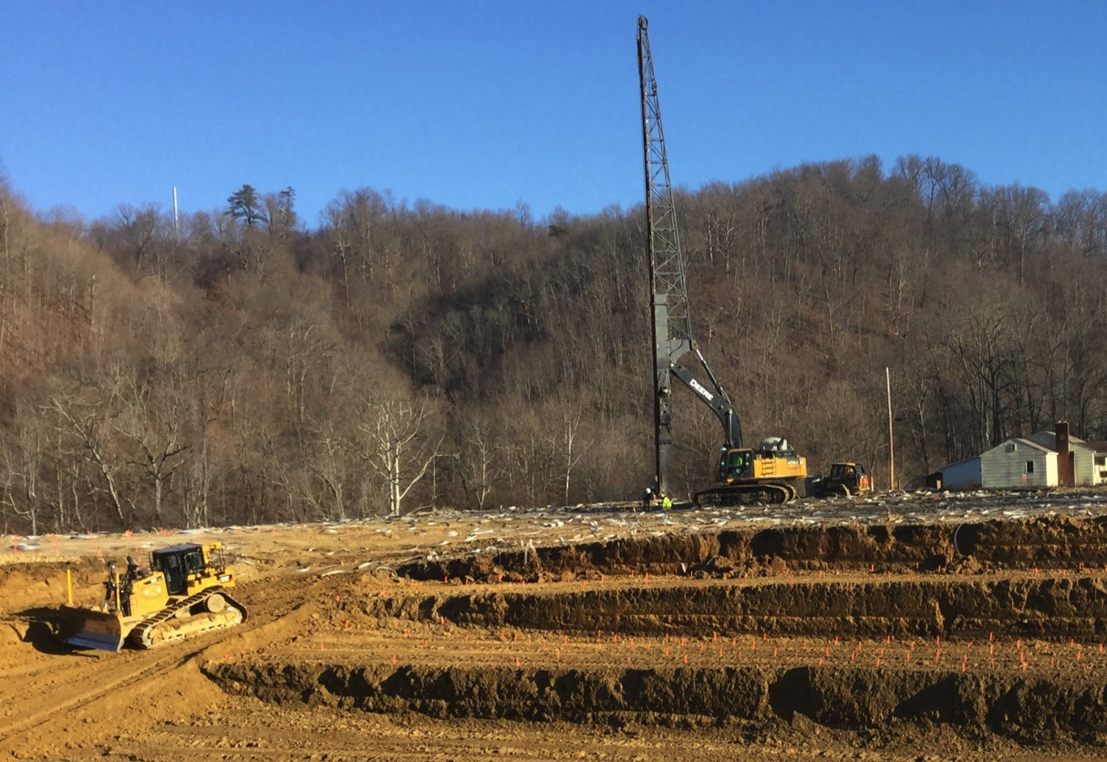
Wick drain installation – January 2016

Slide 45
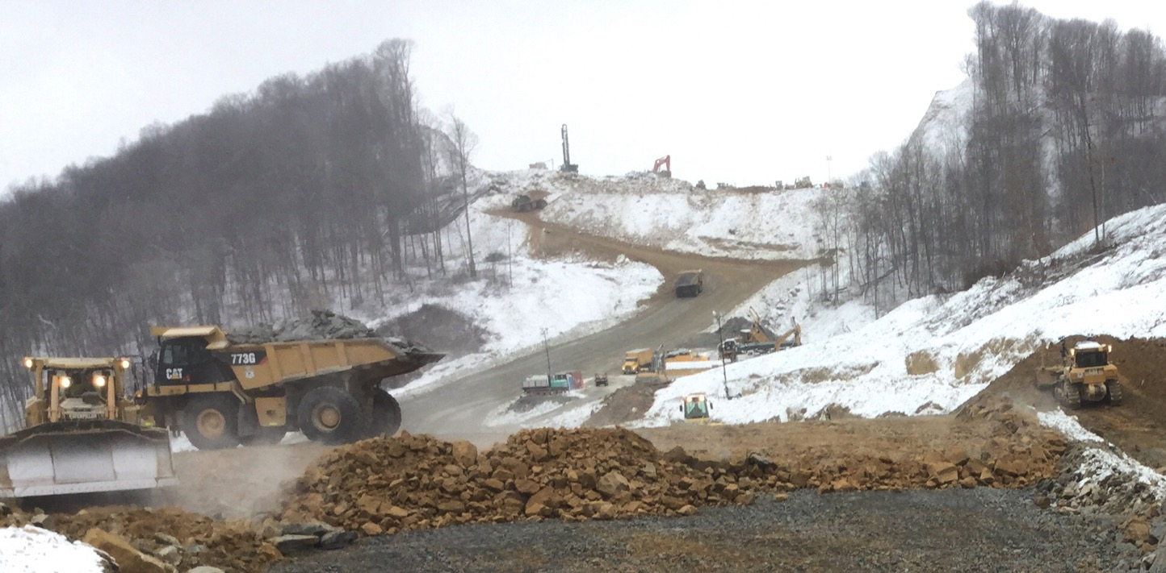
Hitachi 1200 excavating shot rock beside drilling rig drilling production blast holes, CAT 773 dumping shot rock while dozer grades material – January 2016

Slide 46
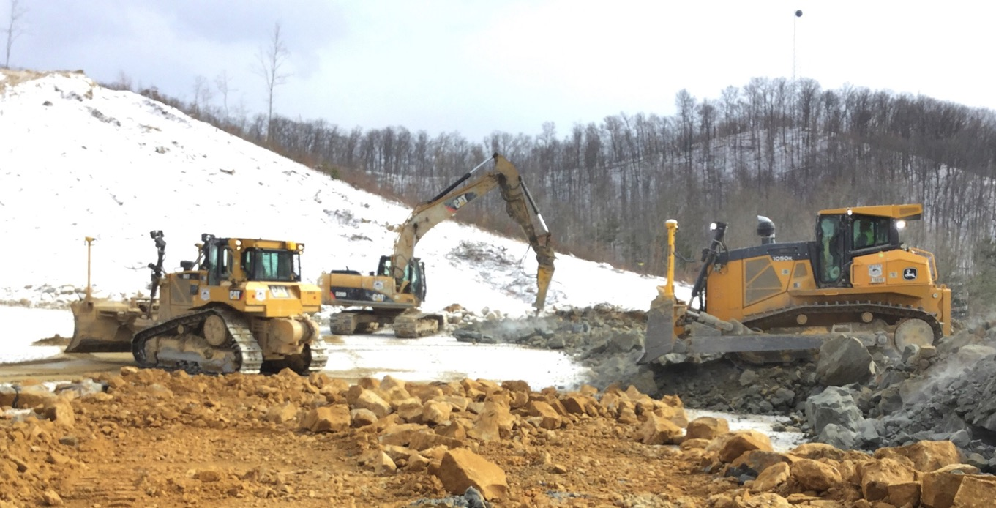
Shot rock placement for embankment while hoe ram breaks up oversized boulder – February 2016

Slide 47
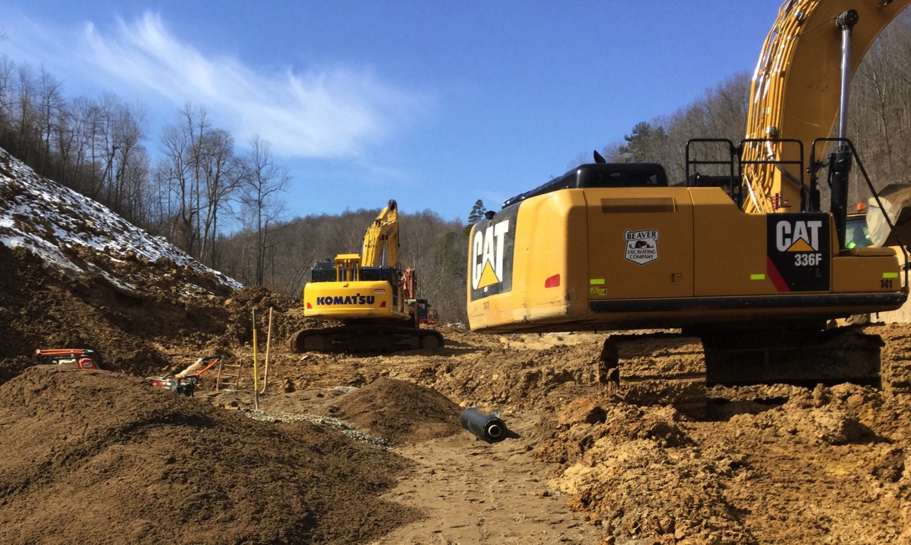
Placement of backfill over culvert – February 2016

Slide 48
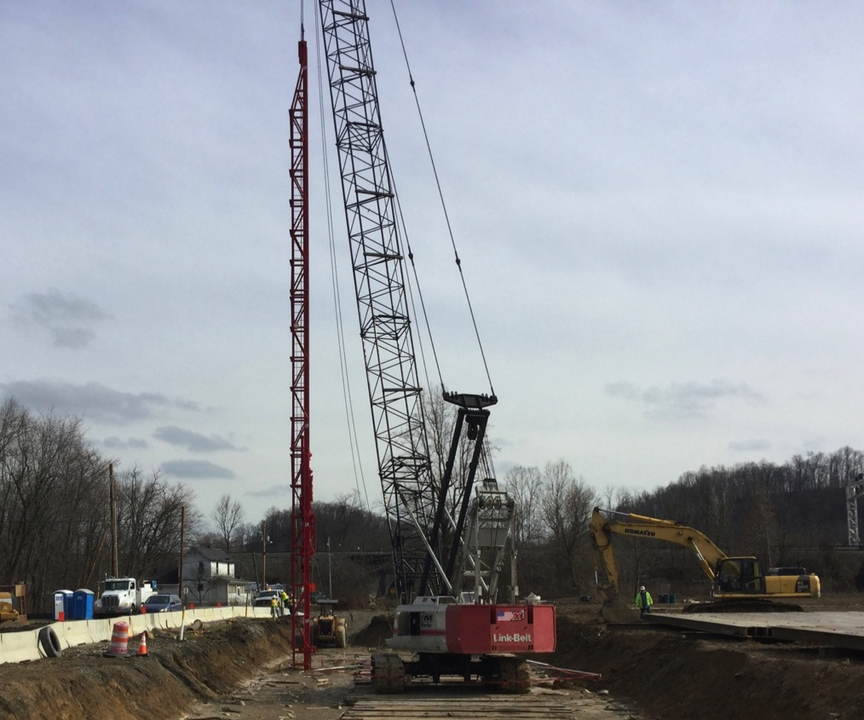
Pile driving for bridge foundation – February 2016

Slide 49
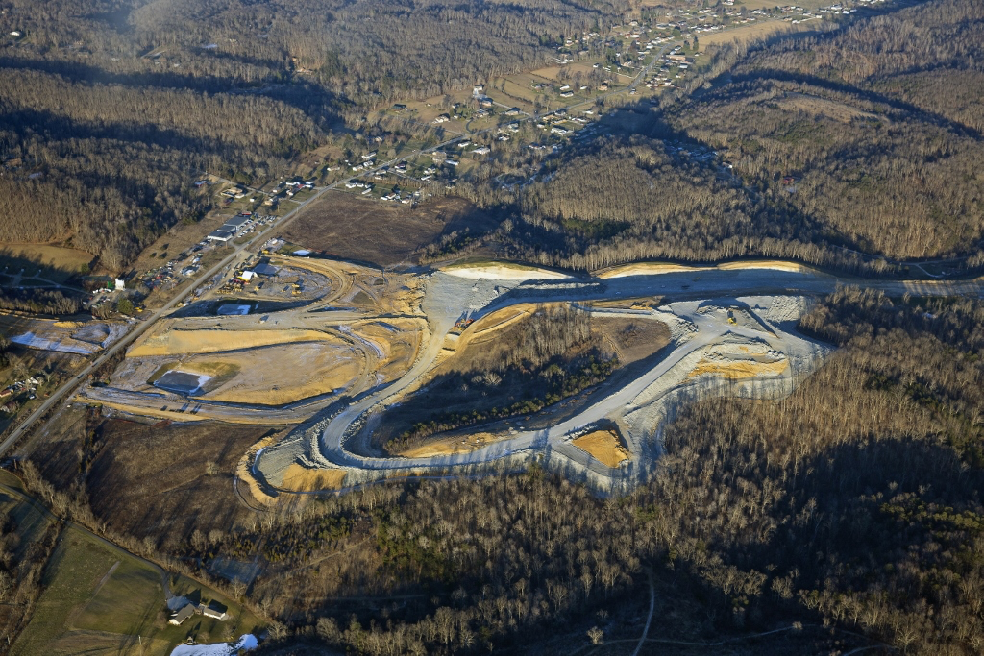
Project Offices
Future Lucasville-Minford interchange – January 2016

